Slide 1

Chapter 13
Current Liabilities and Contingencies
© McGraw Hill LLC. All rights reserved. No reproduction or distribution without the prior written consent of McGraw Hill LLC.
Notes:
Chapter 13 is the first of five chapters devoted to liabilities. In Part A of this chapter, we discuss liabilities that are classified appropriately as current. In Part B we turn our attention to situations in which there is uncertainty as to whether an obligation really exists. These are designated as loss contingencies. Some loss contingencies are accrued as liabilities, but others only are disclosed in the notes.

Slide 2
Characteristics of Liabilities
L O13.1
Liability:
Present obligation to transfer an economic benefit.
Economic benefit can have arisen from a contract or can be implied from past behavior.
A debt that is owed.
Notes:
A liability is a present obligation to transfer an economic benefit. A present obligation can have arisen from a contract or other agreement, or it can be implied from past behavior, such as a company customarily paying vacation pay to employees. The economic benefit that is transferred often is cash, but economic benefits can also be provided by transferring other assets, performing services, or forgoing receipt of economic benefits.
Intuitively, a liability is a debt that you owe. For example, you could pay a large debt by paying cash, by transferring title to your car, by “working it off” with labor, or by canceling a debt owed to you. The key is that you owe it and you can satisfy it in some way.

Slide 3
Current Liabilities
L O13.1
Characteristics:
Obligation payable within one year from the balance sheet date or within the firm’s operating cycle, whichever is longer.
Satisfied with current assets.
Satisfied by creation of other current liabilities.
Notes:
A current liability is often characterized as an obligation that is payable within one year from the balance sheet date or within the firm’s operating cycle, whichever is longer. This general definition usually applies. However, a more discriminating definition identifies current liabilities as those expected to be satisfied with current assets or by the creation of other current liabilities.
Classifying liabilities as either current or long-term helps investors and creditors assess the risk that the liabilities will require expenditure of cash or other assets in the near term. Is the due date years in the future, so the business doesn’t need to pay soon and can spend its cash for other purposes without risking default? Or, will payment require the use of current assets and reduce the amount of liquid funds available for other uses? If near-term payment is required, are sufficient liquid funds available to make necessary payments of liabilities in addition to meeting current operating needs, or must additional funds be obtained by raising capital? The answers to these questions can have significant implications.

Slide 4
Recording Current Liabilities
L O13.1
Liabilities should be recorded at their present values:
Except liabilities payable within one year which are ordinarily recorded at maturity amounts.
Most common examples:
Accounts payable.
Notes payable.
Commercial paper.
Income tax liability.
Dividends payable.
Accrued expenses.
Notes:
Conceptually, liabilities should be recorded at their present values. In other words, the amount recorded is the present value of all anticipated future cash payments resulting from the debt (specifically, principal and interest payments). However, in practice, liabilities payable within one year from the balance sheet date ordinarily are recorded instead at their maturity amounts. This inconsistency usually is inconsequential because the relatively short-term maturity of current liabilities makes the interest or time value component immaterial.
The most common current liabilities are accounts payable, notes payable, commercial paper, income tax liability, dividends payable, and accrued expenses. Liabilities related to income taxes are the subject of Chapter 16.

Slide 5
Current Liabilities—General Mills 1
L O13.1
General Mills, Inc.
Excerpt from Consolidated Balance Sheets
May 28, 2023 and May 29, 2022
Liabilities and Equity (in millions) | May 28, 2023 | May 29, 2022
Current liabilities:
Accounts payable | $4,194.2 | $3,982.3
Current portion of long-term debt | 1,709.1 | 1,674.2
Notes payable | 31.7 | 811.4
Other current liabilities | 1,600.7 | 1,552.0
Total current liabilities | 7,535.7 | 8,019.9
Notes:
Illustration 13–1 Current Liabilities—General Mills
Let’s use the current liability section of the balance sheet of General Mills, Inc., and related disclosure notes to provide perspective on some of the liabilities we discuss. General Mills’ presentation and supplemental footnote disclosures are fairly typical.

Slide 6
Current Liabilities—General Mills 2
L O13.1
Note 9. Debt.
Notes Payable.
The components of notes payable and their respective weighted-average interest rates at the end of the periods were as follows:
In Millions | May 28, 2023 Notes Payable | May 28, 2023 Weighted- Average Interest Rate | May 29, 2022 Notes Payable | May 29, 2022 Weighted- Average Interest Rate
U S commercial paper | $ - | -% | $694.8 | 1.1%
Financial institutions | 31.7 | 10.5% | 116.6 | 4.4%
Total | $31.7 | 10.5% | $811.4 | 5.5%
Notes:
Illustration 13–1 Current Liabilities—General Mills (continued)
Here we see the note on debt—specifically, the amounts and weighted average interest rates for notes payable.

Slide 7
Current Liabilities—General Mills 3
L O13.1
To ensure availability of funds, we maintain bank credit lines and have commercial paper programs available to us in the United States and Europe.
The following table details the fee-paid committed and uncommitted credit lines we had available as of May 28, 2023:
In Billions | Facility Amount | Borrowed Amount
Committed credit facility expiring April 2026 | $2.7 | $-
Uncommitted credit facilities | 0.6 | -
Total committed and uncommitted credit facilities | $3.3 | $-
The credit facilities contain covenants, including a requirement to maintain a fixed charge coverage ratio of at least 2.5 times. We were in compliance with all credit facility covenants as of May 28, 2023.
Notes:
Illustration 13–1 Current Liabilities—General Mills (concluded)
Here we see the note on credit lines and commercial paper.

Slide 8
Accounts Payable and Trade Notes Payable
L O13.1
Obligations to suppliers of merchandise or of services.
Key accounting considerations are:
Determining existence.
Recording in the appropriate accounting period.
Accounts Payable:
Payable on open account.
Credit instrument: invoice.
Short duration.
Noninterest-bearing and reported at face amounts.
Trade Notes Payable:
Credit instrument: written promissory note.
Longer duration.
Bear interest.
Notes:
Accounts payable are obligations to suppliers of merchandise or services purchased on open account. Most trade credit is offered on open account. This means that the only formal credit instrument is the invoice. Because the time until payment usually is short (often 30, 45, or 60 days), these liabilities typically are noninterest-bearing and are reported at their face amounts. The key accounting considerations relating to accounts payable are determining their existence and ensuring that they are recorded in the appropriate accounting period.
Trade notes payable differ from accounts payable in that they are formally recognized by a written promissory note. Often these are of a somewhat longer term than open accounts and bear interest.

Slide 9
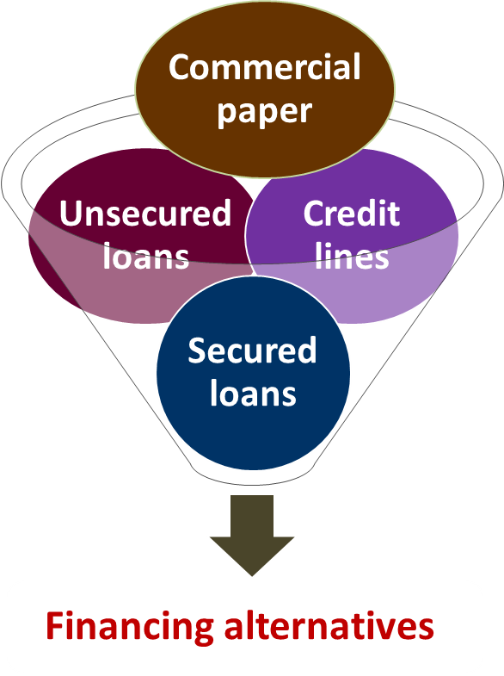
Short-Term Notes Payable
L O13.2
Characteristics:
Temporary financing from bank.
Promissory note is signed.
Lower interest rates than long-term debt.
Companies have flexibility while selecting financial alternatives.
Access the text alternative for slide images.
Notes:
The most common way for a corporation to obtain temporary financing is to arrange a short-term bank loan. When a company borrows cash from a bank and signs a promissory note (essentially an IOU), the firm’s liability is reported as notes payable (sometimes bank loans or short-term borrowings). About two-thirds of bank loans are short term, but because many are routinely renewed, some tend to resemble long-term debt.
Smaller firms often are unable to tap into major sources of long-term financing to the extent necessary to provide for their working capital needs, so they rely heavily on short-term financing. Even large companies typically utilize short-term debt as a significant component of their capital structure. One reason is that short-term funds usually offer lower interest rates than long-term debt. Perhaps most importantly, corporations desire flexibility. Managers want as many financing alternatives as possible.

Slide 10
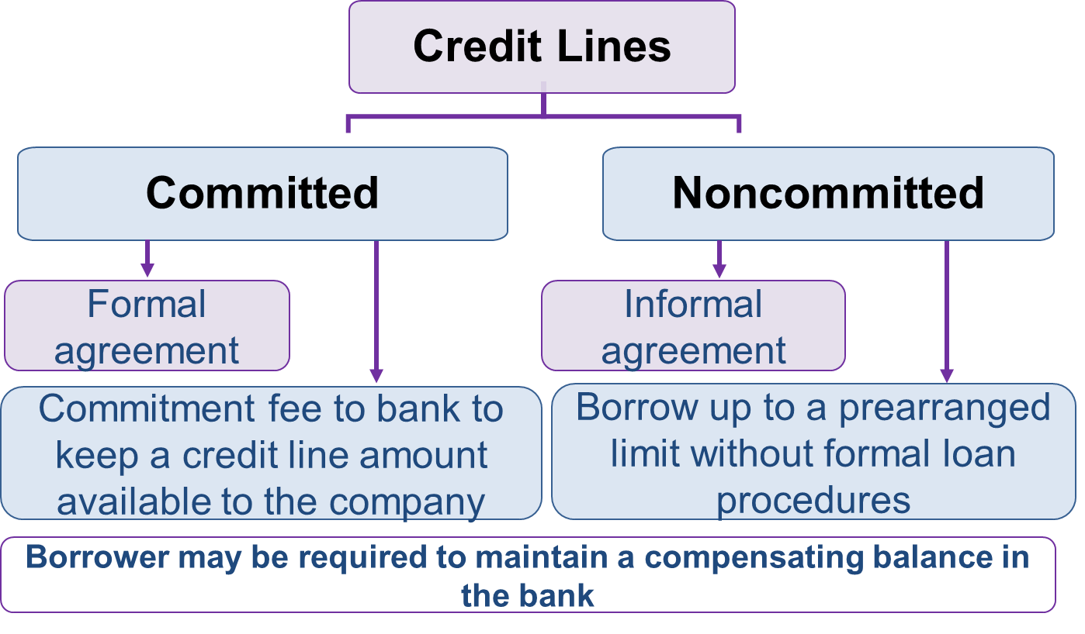
Credit Lines
L O13.2
A line of credit is an agreement to provide short-term financing, with amounts withdrawn by the borrower only when needed.
Access the text alternative for slide images.
Notes:
A line of credit is an agreement with a bank to provide short-term financing, with amounts withdrawn by the borrower only when needed. Even though the loans are short-term, with amounts borrowed and repaid frequently, the agreement to provide a line of credit typically lasts several years. Lines of credit can be noncommitted or committed. A noncommitted line of credit is an informal agreement that permits a company to borrow up to a prearranged limit without having to follow formal loan procedures and paperwork. Banks sometimes require the company to maintain a compensating balance on deposit with the bank, say, 5% of the line of credit. A committed line of credit is a more formal agreement that usually requires the company to pay a commitment fee to the bank to keep a credit line amount available to the company. A typical annual commitment fee is 0.25% of the total committed funds and may also require a compensating balance.

Slide 11
Disclosure of Credit Lines—I B M Corporation
L O13.2
Note P. Borrowings (in part):
Lines of Credit: On June 30, 2022, the company amended its existing $2.5 billion Three-Year Credit Agreement and $7.5 billion Five-Year Credit Agreement (the Credit Agreements) to extend the maturity dates to June 20, 2025, and June 22, 2027, respectively, and to replace the London Interbank Offered Rate (L I B O R) interest rate provisions with customary provisions based on the Secured Overnight Financing Rate (S O F R). The Credit Agreements permit the company and its subsidiary borrowers to borrow up to $10 billion on a revolving basis. The total expense recorded by the company related to these agreements was $11 million, $12 million, and $12 million in 2022, 2021, and 2020, respectively. . . . As of December 31, 2022, there were no material borrowings by the company under these credit facilities.
Notes:
Illustration 13–2 Disclosure of Credit Lines—IBM Corporation
A recent annual report of IBM Corporation illustrates noncommitted lines of credit.

Slide 12
Interest
L O13.2
Paid when a company borrows money.
Return for using lender’s money.
Stated in terms of a percentage rate to be applied to the face amount of the loan.
Face amount
Annual rate
Time to maturity
×
×
Notes:
When a company borrows money, it pays the lender interest in return for using the lender’s money during the term of the loan. You might think of the interest as the “rent” paid for using money. An interest-bearing note has interest stated in terms of a percentage rate to be applied to the face amount of the loan. Because the stated rate typically is an annual rate, when calculating interest for a short-term note we must adjust for the fraction of the annual period the loan spans.
Interest on notes is calculated as: Face amount × Annual rate × Time to maturity

Slide 13
Note Issued for Cash
L O13.2
On May 1, Affiliated Technologies, Inc., a consumer electronics firm, borrowed $700,000 cash from First BancCorp under a noncommitted short-term line of credit arrangement and issued a six-month, 12% promissory note. Interest was payable at maturity.
Journal Entry | Debit | Credit
May 1
Cash | 700,000
Notes payable |  | 700,000
November 1
Interest expense ($700,000 × 12% × 6÷12) | 42,000
Notes payable | 700,000
Cash |  | 742,000
Notes:
Illustration 13–3 Interest-Bearing Notes Payable
As an illustration, Affiliated Technologies issued a six-month, 12% promissory note on May 1. To record the issuance of the note, we debit Cash and credit Notes payable for $700,000.
Next, on November 1, we record interest on maturity of the note. The interest is calculated by multiplying the face amount of $700,000 by the 12% annual rate, adjusted for six months. Therefore, the amount of interest equals $42,000 for the period for six months. As the note is collected on November 1, we reduce the liability by debiting Notes payable for $700,000 and crediting Cash for the total amount of $742,000.

Slide 14
Noninterest-Bearing Note 1
L O13.2
On May 1, Affiliated Technologies, Inc., a consumer electronics firm, bought inventory worth $658,000 by issuing a $700,000 noninterest-bearing note due in six months.
Journal Entry | Debit | Credit
May 1
Inventory (difference) | 658,000
Discount on notes payable (to balance) | 42,000
Notes payable (face amount) |  | 700,000
November 1
Interest expense | 42,000
Discount on notes payable |  | 42,000
Notes payable (face amount) | 700,000
Cash |  | 700,000
Notes:
A noninterest-bearing note doesn’t explicitly state an interest rate. Instead, the interest is deducted (or discounted) from the face amount to determine the cash proceeds made available to the borrower at the outset.
In a previous chapter, an example was presented when a company sold a product worth $658,000 and accepted a note receivable from the customer of $700,000 due in six months. While the note had no stated interest rate, implicit in the higher amount of the note is interest of $42,000 ($700,000 − $658,000). We can apply the same concept to our previous example. Suppose Affiliated Technologies bought inventory worth $658,000 by issuing a $700,000 noninterest-bearing note due in six months. The difference of $42,000 is recorded as a discount on notes payable that will be recognized as interest expense over time.

Slide 15
Noninterest-Bearing Note 2
L O13.2
Sometimes interest in such arrangements is described by referring to a discount rate that is applied to the face amount of the note. In this case, the six-month noninterest-bearing note would be described as “being discounted at issuance at a 12% discount rate”. The amount borrowed under this arrangement is only $658,000, but the interest is calculated as the discount rate times the $700,000 face amount times the fraction of the year the note is outstanding. This causes the effective interest rate to be higher than the 12% stated rate:
To annualize:
When interest is discounted from the face amount of a note, the effective interest rate is higher than the stated discount rate.
Notes:
Sometimes interest in such arrangements is described by referring to a discount rate that is applied to the face amount of the note. In this case, the six-month noninterest-bearing note would be described as “being discounted at issuance at a 12% discount rate,” and the amount of interest would be calculated as the face amount times the discount rate times the fraction of the year the note is outstanding ($700,000 × 12% × 6/12 = $42,000). Notice, though, that the amount borrowed under this arrangement is only $658,000. This causes the effective interest rate to be higher than the 12% stated rate:
$42,000 Interest for 6 months/$658,000 Amount borrowed = 6.38% Rate for 6 months
To annualize: 6.38% × 12⁄6 = 12.76% Effective interest rate

Slide 16
Secured Loans
L O13.2
Loan made by pledging a specified asset of the borrower as collateral or security.
Pledging accounts receivable:
When accounts receivable serves as a collateral.
Factoring receivables:
When the receivables actually are sold outright to a finance company.
Notes:
Sometimes short-term loans are secured, meaning a specified asset of the borrower is pledged as collateral or security for the loan. Although many kinds of assets can be pledged, the secured loans most frequently encountered in practice are secured by inventory or accounts receivable.
When accounts receivable serve as collateral, we refer to the arrangement as pledging accounts receivable. Sometimes, the receivables actually are sold outright to a finance company as a means of short-term financing. This is called factoring receivables.

Slide 17
Commercial Paper
L O13.1
Refers to unsecured notes sold in minimum denominations of $25,000 with maturities ranging from 1 to 270 days.
Beyond 270 days the firm would be required to file a registration statement with the S E C.
Interest often is discounted at issuance of the note.
Usually, commercial paper is issued directly to the buyer (lender) and is backed by a line of credit with a bank.
This allows the interest rate to be lower than in a bank loan.
Notes:
Commercial paper refers to unsecured notes sold in minimum denominations of $25,000 with maturities ranging from 1 to 270 days (beyond 270 days, the firm would be required to file a registration statement with the SEC). Interest often is discounted at the issuance of the note. Usually, commercial paper is issued directly to the buyer (lender) and is backed by a line of credit with a bank. This allows the interest rate to be lower than in a bank loan. Large, highly rated firms sometimes sell commercial paper to borrow funds at a lower rate.
The name commercial paper refers to the fact that a paper certificate traditionally is issued to the lender to signify the obligation, but now these transactions are handled digitally so typically no paper is used. Since commercial paper is a form of notes payable, recording its issuance and payment is exactly the same as our earlier illustration.

Slide 18
Real World Financials ― Disclosures 1
L O13.2
Disclosure of Notes Secured by Notes Receivable – Deere & Company.
Note 12. Securitization of Financing Receivables:
Repayment of the secured borrowings depends on cash flows generated by the restricted assets.
Disclosure of Commercial Paper—Comcast Corporation.
Note 6. Long-Term Debt (in part):
Our commercial paper program is supported by our revolving credit facility and provides a lower cost source of borrowing to fund short-term working capital requirements. As of December 31, 2022, $665 million was outstanding under our commercial paper program. . . . As of December 31, 2022, amounts available under our revolving credit facility, net of amounts outstanding under our commercial paper program and outstanding letters of credit and bank guarantees, totaled $10.4 billion.
Notes:
Illustration 13-4 – Disclosure of Notes Secured by Notes Receivable – Deere & Company
This illustration describes the relation between secured notes and related assets.
Illustration 13-5 Disclosure of Commercial Paper—Comcast Corporation
This illustration includes a disclosure note from the 2022 annual report of Comcast Corporation that describes Comcast’s commercial paper program.

Slide 19
Accrued Expenses
L O13.3
Represent expenses already incurred but not yet paid (accrued liabilities).
Recorded by adjusting entries.
Usually combined and reported under a single caption in the balance sheet.
Common examples:
Salaries payable.
Income taxes payable.
Interest payable.
Notes:
Accrued expenses represent expenses already incurred but not yet paid. These liabilities are recorded by adjusting entries at the end of the reporting period, prior to preparing financial statements. Common examples are salaries payable, income taxes payable, and interest payable. Although recorded in separate liability accounts, accrued expenses usually are combined and reported under a single caption or perhaps two accrued expense (or sometimes accrued liability) captions in the balance sheet.

Slide 20
Note with Accrued Interest 1
L O13.3
On May 1, Affiliated Technologies, Inc., borrowed $700,000 cash from First BancCorp under a noncommitted short-term line of credit arrangement and issued a six-month, 12% promissory note. Interest was payable at maturity. Assume the fiscal period for Affiliated Technologies ends on June 30, two months after the six-month note is issued.
Journal Entry | Debit | Credit
Issuance of Note on May 1
Cash | 700,000
Notes payable |  | 700,000
Accrual of interest on June 30
Interest expense ($700,000 × 12% × 2÷12) | 14,000
Interest payable |  | 14,000
Notes:
Illustration 13–6 Note with Accrued Interest
Accrued interest payable arises in connection with notes payable (as well as other forms of debt). As a continuation of our previous example, let’s assume the fiscal period for Affiliated Technologies ends on June 30, two months after the six-month note is issued.
The issuance of the note and accrual of interest on June 30 is shown here. At June 30, two months’ interest has accrued and is recorded to avoid misstating expenses and liabilities on the June 30 financial statements.

Slide 21
Note with Accrued Interest 2
L O13.3
On May 1, Affiliated Technologies, Inc., borrowed $700,000 cash from First BancCorp under a noncommitted short-term line of credit arrangement and issued a six-month, 12% promissory note. Interest was payable at maturity. Assume the fiscal period for Affiliated Technologies ends on June 30, two months after the six-month note is issued.
Journal Entry | Debit | Credit
Note payment on November 1
Interest expense ($700,000 × 12% × 4÷12) | 28,000
Interest payable (from June 30 accrual) | 14,000
Notes payable | 700,000
Cash ($700,000 + $42,000) |  | 742,000
Notes:
Illustration 13–6 Note with Accrued Interest (continued)
On November 1, the company records cash payment upon maturity of the note. Notes payable is reduced with a debit entry and cash is reduced with a credit entry. Interest expense is debited for the four months after June 30, calculated as $28,000, and the interest payable recorded on June 30 is reduced with a debit entry of $14,000.

Slide 22
Salaries, Commissions, and Bonuses
L O13.3
Accrued expenses arise when employees have provided services but will be paid after the financial statement date.
If the conditions below are met, the employer clearly has a liability (a present obligation to transfer an economic benefit).
Vacations, Sick Days, and Other Paid Future Absences:
Four conditions for accrual of paid future absences:
The obligation is attributable to employees’ services already performed.
The paid absence can be taken in a later year—the benefit vests (will be compensated even if employment is terminated) or the benefit can be accumulated over time.
Payment is probable.
The amount can be reasonably estimated.
Notes:
Illustration 13–7 Conditions for Accrual of Paid Future Absences
Compensation for employee services can be in the form of hourly wages, salary, commissions, bonuses, stock compensation plans, and pensions. Accrued expenses arise when employees have provided services but will be paid after the financial statement date. These accrued expenses are recorded by adjusting entries at the end of the reporting period, prior to preparing financial statements.
Suppose a firm grants two weeks of paid vacation each year to employees. Some employees take their vacations during each period in which the vacations are earned and are compensated then. Some instead accumulate those days and use them in a future period. Should the firm recognize compensation expense during the period for only those employees who actually are paid that period for their absence?
An employer should accrue an expense and the related liability for employees’ compensation for future absences (such as vacation pay) if the obligation meets all of the four conditions listed here:
The obligation is attributable to employees’ services already performed.
The paid absence can be taken in a later year—the benefit vests (will be compensated even if employment is terminated) or the benefit can be accumulated over time.
Payment is probable.
The amount can be reasonably estimated.
If these conditions are met, the employer clearly has a liability (a present obligation to transfer an economic benefit). Also, these conditions are consistent with the requirement that we accrue loss contingencies only when the obligation is both (a) probable and (b) can be reasonably estimated.

Slide 23
Paid Future Absences 1
L O13.3
Davidson-Getty Chemicals has 8,000 employees. Each employee earns two weeks of paid vacation per year. Vacation time not taken in the year earned can be carried over to subsequent years. During 2027, 2,500 employees took both weeks’ vacation, but at the end of the year, 5,500 employees had vacation time carryovers as follows:
Employees | Vacation Weeks Earned But Not Taken | Total carryover weeks
2,500 | 0 | 0
2,000 | 1 | 2,000
3,500 | 2 | 7,000
8,000 |  | 9,000
During 2027, compensation averaged $600 a week per employee. In 2028, when vacation time carried over from 2027 is taken, the actual amount paid to employees is $5,700,000.
Notes:
Illustration 13–8 Paid Future Absences
Here’s an example of accounting for paid future absences. The liability for paid absences usually is accrued at the existing wage rate rather than at a rate estimated to be in effect when absences occur. So, if wage rates have risen, the difference between the accrual and the amount paid increases compensation expense in the year in which the absences occur.

Slide 24
Paid Future Absences 2
L O13.1
Journal Entry | Debit | Credit
When vacations were taken in 2027
Salaries expense (2,500 × 2 weeks × $600) + (2,000 × 1 week × $600) | 4,200,000
Cash (or salaries payable) |  | 4,200,000
December 31, 2027 (adjusting entry) | Debit | Credit
When vacations were taken in 2027
Salaries expense (9,000 carryover weeks × $600) | 5,400,000
Liability—compensated future absences |  | 5,400,000
Assume in 2028 actual amount paid is $5.7M
When year 2027 vacations are taken in 2028 | Debit | Credit
Liability—compensated future absences | 5,400,000
Salaries expense | 300,000
Cash (or salaries payable) |  | 5,700,000
Notes:
Illustration 13–8 Paid Future Absences (continued)
The salaries expense for employees who took vacations in 2027 is calculated at the existing wage rate of $600. This expense for 2,500 employees for 2 weeks and 2,000 employees for 1 week totals $4,200,000.
The amount of compensation expense to be accrued on December 31, 2027, is calculated as the total carryover of 9,000 weeks times the wage rate of $600, which equals $5,400,000. It is recorded as a liability towards compensated future absences.
The liability for paid absences usually is accrued at the existing wage rate rather than at a rate estimated to be in effect when absences occur. So, if wage rates have risen, the difference between the accrual and the amount paid increases compensation expense that year. This situation is demonstrated here, in which vacation time carried over from 2027 is taken in 2028 and the actual amount paid to employees is $5,700,000.

Slide 25
Annual Bonuses
L O13.3
Features:
Tied to performance objectives to provide incentive to executives.
Are compensation expense of the period in which they are earned, so unpaid bonuses are accrued as a liability at year-end.
Most common performance measures:
Financial:
Earnings per share.
Net income.
Operating income.
Nonfinancial:
Customer satisfaction.
Product or service quality.
Notes:
Sometimes compensation packages include annual bonuses tied to performance objectives designed to provide incentives to executives. Bonuses are compensation expense of the period in which they are earned, so unpaid bonuses are accrued as a liability at year-end.
The most common performance measures are earnings per share, net income, and operating income, each being used by about a quarter of firms having bonus plans. Nonfinancial performance measures, such as customer satisfaction and product or service quality, also are used. For employees, bonuses unfortunately may take the place of annual raises. This allows a company to increase employee pay without permanently locking in the increases in salaries.

Slide 26
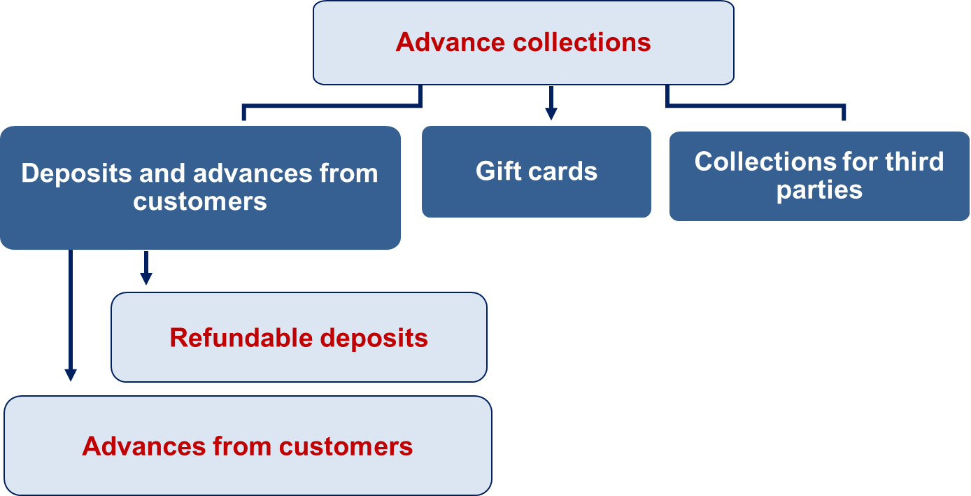
Liabilities from Advance Collections
L O13.3
Liabilities are created when deposits and advances are received from customers.
Access the text alternative for slide images.
Notes:
Deposits and advances from customers, as well as collections for third parties, present situations where liabilities are created to either make payments or provide goods or services in the future.
Collecting cash from a customer as a refundable deposit or as an advance payment for products or services creates a liability to return the deposit or to supply the products or services.

Slide 27
Refundable Deposits 1
L O13.3
Rancor Chemical Company sells combustible chemicals in expensive, reusable containers. Customers are charged a deposit for each container delivered and receive a refund when the container is returned. Deposits collected on containers delivered during the year were $300,000. Deposits are forfeited if containers are not returned within one year. Ninety percent of the containers were returned within the allotted time. Deposits charged are twice the actual cost of containers. The inventory of containers remains on the company’s books until deposits are forfeited.
Journal Entry | Debit | Credit
When Deposits are Collected
Cash | 300,000
Liability—refundable deposits |  | 300,000
Notes:
Illustration 13–9 Refundable Deposits
In some businesses it’s typical to require customers to pay cash as a deposit that will be refunded when a specified event occurs. You probably have encountered such situations. When apartments are rented, security or damage deposits often are collected. Utility companies frequently collect deposits when service is begun. Similarly, deposits sometimes are required on returnable containers, to be refunded when the containers are returned. That situation is demonstrated in the example above.

Slide 28
Refundable Deposits 2
L O13.3
Journal Entry | Debit | Credit
When Containers are Returned
Liability—refundable deposits ($300,000 × 90%) | 270,000
Cash |  | 270,000
When Deposits are Forfeited
Liability—refundable deposits ($300,000 − $270,000) | 30,000
Revenue—sale of containers |  | 30,000
Cost of goods sold ($30,000 ÷ 2) | 15,000
Inventory of containers |  | 15,000
Notes:
Illustration 13–9 Refundable Deposits (continued)
When 90% of the containers are returned within the allotted time, the previously collected deposit amount is refunded. The liability recorded earlier for the refund is reduced by 90% of the refundable amount, which is $270,000. This is recorded as a debit to the Liability account and credit to Cash for $270,000.
Note that 10% of the customers did not return the containers. Consequently, revenue is credited for the remaining amount, which equals $30,000.
As the deposits were charged twice the actual cost of containers, cost of goods sold is debited for the cost of $15,000, and inventory is decreased for the containers not returned.

Slide 29
Advances from Customers
L O13.3
Represent liabilities until the product or service is provided or the advance collected.
Examples:
Gift certificates.
Magazine subscriptions.
Layaway deposits.
Special order deposits.
Airline tickets.
Notes:
At times, businesses require advance payments from customers that will be applied to the purchase price when goods are delivered or services provided. Gift certificates, magazine subscriptions, layaway deposits, special order deposits, and airline tickets are examples. These customer advances, also called deferred revenue or unearned revenue, represent liabilities until the related product or service is provided.

Slide 30
Customer Advance
L O13.3
Tomorrow Publications collects magazine subscriptions from customers at the time subscriptions are sold. Subscription revenue is recognized over the term of the subscription. Tomorrow collected $20 million in subscription sales during its first year of operations. At December 31, the average subscription was one-fourth expired.
Journal Entry | ($ in millions) Debit | ($ in millions) Credit
When advance is collected
Cash | 20
Deferred subscription revenue |  | 20
When product is delivered
Deferred subscription revenue | 5
Subscription revenue |  | 5
Notes:
Illustration 13–10 Customer Advance
This illustration highlights that deferred revenue gets reduced when the revenue associated with the advance has been recognized, either because the seller has delivered the goods or services as promised or because the buyer has forfeited the advance payment (for example, not redeeming a gift certificate before it expires). Less often, deferred revenue is reduced when an advance payment is returned by the seller to the buyer because the seller didn’t deliver the goods or services as promised.
Note that at December 31, the average subscription was one-fourth expired. Thus, the seller has performed one-fourth of its obligation to deliver a year’s worth of magazines and should recognize subscription revenue for that amount. Deferred subscription revenue is reduced with a debit entry by one-fourth, or $5 million, and revenue is recorded with a credit to subscription revenue.

Slide 31
Gift Cards (Gift Certificates)
L O13.3
Cash received for sale of gift card recorded as deferred revenue.
Later recognition of revenue:
On redemption.
On breakage (“remote probability of redemption”).
Notes:
Gift cards or gift certificates are particularly common forms of advanced payments. When a company sells a gift card, it initially records the cash received as deferred revenue, and then recognizes revenue either when the gift card is redeemed or when the probability of redemption is viewed as remote (called gift card breakage, and based on expiration or the company’s experience).
Liabilities for deferred revenue associated with gift cards are classified as current or long-term depending on when the obligation is expected to be satisfied.

Slide 32
Accounting for Gift Cards
L O13.3
During May 2027, Great Buy, Inc., sold $2 million of gift cards. Also during May, $1.5 million of gift cards sold in May and in prior periods were redeemed by customers, and $1 million of gift cards sold in prior periods expired and were unused.
Journal Entry | Debit | Credit
To record sale of gift cards
Cash | 2,000,000
Deferred gift card revenue |  | 2,000,000
To record redemption of gift cards (ignoring entries to inventory and cost of sales)
Deferred gift card revenue | 1,500,000
Revenue—gift cards |  | 1,500,000
To record expiration of gift cards
Deferred gift card revenue | 1,000,000
Revenue—gift cards |  | 1,000,000
Notes:
Illustration 13–11 Accounting for Gift Cards
During May 2027, Great Buy, Inc. sold $2 million of gift cards. To record this transaction, cash is debited and deferred gift card revenue is credited for $2 million.
Also during May, $1.5 million of gift cards sold in prior periods were redeemed by customers. Thus, we debit the deferred revenue account while crediting revenue for $1.5 million.
Finally, $1 million of gift cards sold in prior periods expired unused. This further decreases the deferred revenue by $1 million and increases revenue by the same amount.

Slide 33
Collections for Third Parties 1
L O13.3
Companies often make collections for third parties from customers or from employees and periodically remit these amounts to the appropriate governmental (or other) units. Amounts collected this way represent liabilities until remitted.
Most Common Examples.
Payroll-related deductions such as:
Sales tax.
Withholding taxes.
Social Security taxes.
Employee insurance.
Employee contributions to retirement plans.
Union dues.
Notes:
Companies often make collections for third parties from customers or from employees and periodically remit these amounts to the appropriate governmental (or other) units. Amounts collected this way represent liabilities until remitted.
Payroll-related deductions such as withholding taxes, Social Security taxes, employee insurance, employee contributions to retirement plans, and union dues create current liabilities until the amounts collected are paid to appropriate parties.

Slide 34
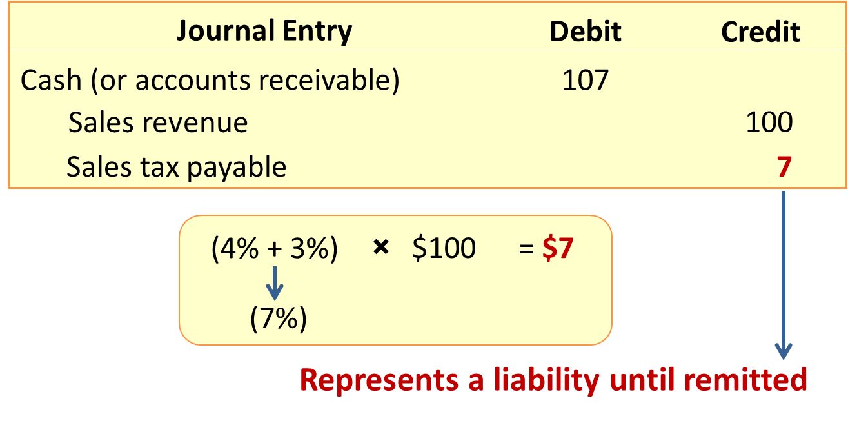
Collections for Third Parties 2
L O13.3
Assume a state sales tax rate of 4% and local sales tax rate of 3%. A sale is made for $100.
Access the text alternative for slide images.
Notes:
An example of collections for third parties is sales tax. Assume a state sales tax rate of 4% and local sales tax rate of 3%. Adding the tax to a $100 sale creates a $7 liability until the tax is paid.
Sales tax collected from customers represent liabilities until remitted.

Slide 35
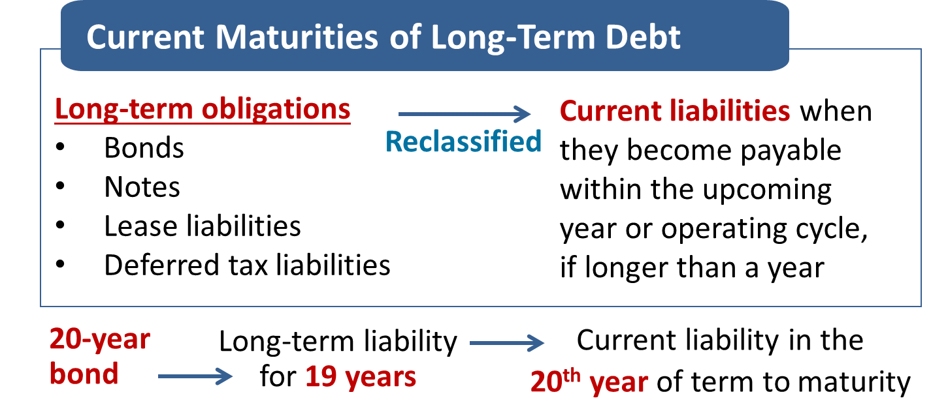
Current and Noncurrent Classification
L O13.4
Companies typically prefer to report an obligation as noncurrent rather than current.
Noncurrent classification results in higher working capital and a higher current ratio.
Access the text alternative for slide images.
Notes:
Given a choice, do you suppose management would prefer to report an obligation as a current liability or as a noncurrent liability? Other things being equal, most would choose the noncurrent classification. Outsiders (like banks, bondholders, and shareholders) consider debt that is payable currently to be riskier than debt that need not be paid for some time, because the current payable requires the company to be able to access the necessary cash relatively soon. Also, the long-term classification enables the company to report higher working capital (current assets minus current liabilities) and a higher current ratio (current assets/current liabilities). Working capital and the current ratio often are explicitly restricted in loan contracts.
Long-term obligations (bonds, notes, lease liabilities, deferred tax liabilities) usually are reclassified and reported as current liabilities when they become payable within the upcoming year (or operating cycle, if longer than a year). For example, a 20-year bond issue is reported as a long-term liability for 19 years but normally is reported as a current liability on the balance sheet prepared during the 20th year of its term to maturity.

Slide 36
Obligations Callable by the Creditor
L O13.4
The requirement to classify currently maturing debt as a current liability includes:
Debt that is callable (due on demand) by the creditor in the upcoming year/operating cycle, even if the debt is not expected to be called.
When the creditor has the right to demand payment because an existing violation of a provision of the debt agreement makes it callable.
Debt is not yet callable but will be callable within the year if an existing violation is not corrected within a specified grace period.
Notes:
The requirement to classify currently maturing debt as a current liability includes debt that is callable (in other words, due on demand) by the creditor in the upcoming year (or operating cycle, if longer), even if the debt is not expected to be called. Debt must be classified as a current liability if the creditor has the right to demand payment because an existing violation of a provision of the debt agreement makes it callable (say, working capital has fallen below a minimum covenant specified by a debt agreement). This also includes situations in which debt is not yet callable but will be callable within the year if an existing violation is not corrected within a specified grace period (unless it’s probable the violation will be corrected within the grace period or waived by the creditor).

Slide 37
When Short-Term Obligations Are Expected to Be Refinanced
L O13.4
Short-term obligations that are expected to be refinanced on a long-term basis can be reported as noncurrent liabilities if two conditions are met:
The company must intend to refinance on a long-term basis, and,
The company must actually have demonstrated the ability to refinance on a long-term basis.
This is demonstrated by an existing refinancing agreement or actual financing prior to the issuance of financial statements.
Notes:
Reconsider the 20-year bond issue we discussed earlier. Normally we would reclassify it as a current liability on the balance sheet prepared during its 20th year. But suppose a second 20-year bond issue is sold specifically to refund the first issue when it matures. Do we have a long-term liability for 19 years, then a current liability in year 20, and then another long-term liability in years 21 and beyond? Or, do we have a single 40-year, long-term liability? The substance of the events obviously supports a single, continuing, noncurrent obligation. The concept of substance over form influences the classification of obligations expected to be refinanced.
Short-term obligations (including callable obligations) that are expected to be refinanced on a long-term basis can be reported as noncurrent, rather than current, liabilities only if two conditions are met:
The company must intend to refinance on a long-term basis, and
The company must actually have demonstrated the ability to refinance on a long-term basis.
The ability to refinance on a long-term basis can be demonstrated by either an existing refinancing agreement or by actual financing prior to the issuance of the financial statements.

Slide 38
Refinancing Short-Term Obligations
L O13.1
Brahm Bros. Ice Cream had $12 million of notes that mature in May 2028 and also had $4 million of bonds issued in 1998 that mature in February 2028. On December 31, 2027, the company’s fiscal year-end, management intended to refinance both on a long-term basis.
On February 7, 2028, the company issued $4 million of 20-year bonds, applying the proceeds to repay the bond issue that matured that month. In early March, prior to the actual issuance of the 2027 financial statements, Brahm Bros. negotiated a line of credit with a commercial bank for up to $7 million any time during 2028. Any borrowings will mature two years from the date of borrowing.
 | December 31, 2027 ($ in thousands)
Classification
Current Liabilities
Notes Payable ($12,000 − $7,000) | $5,000
Long-Term Liabilities
Notes Payable | $7,000
Bonds Payable | 4,000
Notes:
Illustration 13–12 Short-Term Obligations that Are Expected to Be Refinanced on a Long-Term Basis
Brahm Bros. Ice Cream had $12 million of notes that mature in May 2028 and also had $4 million of bonds issued in 1998 that mature in February 2028. On December 31, 2027, the company’s fiscal year-end, management intended to refinance both on a long-term basis.
On February 7, 2028, the company issued $4 million of 20-year bonds, applying the proceeds to repay the bond issue that matured that month. In early March, prior to the actual issuance of the 2027 financial statements, Brahm Bros. negotiated a line of credit with a commercial bank for up to $7 million any time during 2028. Any borrowings will mature two years from the date of borrowing.
Management’s ability to refinance the $4 million of bonds on a long-term basis was demonstrated by actual financing prior to the issuance of the financial statements. Management’s ability to refinance $7 million of the $12 million of notes was demonstrated by a refinancing agreement. The remaining $5 million must be reported as a current liability.
If shares of stock had been issued to refinance the bonds in the illustration, the bonds still would be excluded from classification as a current liability. The specific form of the long-term refinancing (bonds, bank loans, equity securities) is irrelevant when determining the appropriate classification.

Slide 39
International Financial Reporting Standards—Classification of Liabilities to Be Refinanced
L O13.7
U S G A A P | I F R S
Liabilities payable within the coming year are classified as long-term liabilities if refinancing is completed before the date of issuance of the financial statements. | To be classified as long-term, liabilities must be refinanced before the balance sheet date.
Notes:
Under U.S. GAAP, liabilities payable within the coming year are classified as long-term liabilities if refinancing is completed before the date of issuance of the financial statements. Under IFRS, refinancing must be completed before the balance sheet date.

Slide 40
Loss Contingencies
L O13.5
A loss contingency is an existing, uncertain situation involving potential loss depending on a future event.
Whether a contingency is accrued and reported as a liability depends on:
The likelihood that the confirming event will occur.
What can be determined about the amount of loss.
U S G A A P requires that the likelihood that the future event be categorized as probable, reasonably possible, or remote.
Probable | Confirming event is likely to occur.
Reasonably possible | The chance the confirming event will occur is more than remote but less than likely.
Remote | The chance the confirming event will occur is slight.
Also key to reporting a contingent liability is its dollar amount. The amount of the potential loss is classified as either known, reasonably estimable, or not reasonably estimable.
Notes:
A loss contingency is an existing, uncertain situation involving potential loss depending on whether some future event occurs. Whether a contingency is accrued and reported as a liability depends on (a) the likelihood that the confirming event will occur and (b) what can be determined about the amount of loss.
Note that we only account for a loss contingency when the event that gave rise to it occurred before the financial statement date. Otherwise, regardless of the likelihood of the eventual outcome, no liability existed at the statement date.
Generally accepted accounting principles require that the likelihood that the future event(s) will confirm the incurrence of the liability be (somewhat arbitrarily) categorized as probable, reasonably possible, or remote.
Probable Confirming event is likely to occur.
Reasonably possible The chance the confirming event will occur is more than remote but less than likely.
Remote The chance the confirming event will occur is slight
Also key to reporting a contingent liability is its dollar amount. The amount of the potential loss is classified as either known, reasonably estimable, or not reasonably estimable.

Slide 41
Disclosure of Potential Contingent Losses General Motors Company
L O13.5
Note 16. Commitments and Contingencies (in part):
Various other legal actions, including class actions, governmental investigations, claims and proceedings, are pending against us or our related companies or joint ventures, including, but not limited to, matters arising out of alleged product defects; employment-related matters; product and workplace safety, vehicle emissions and fuel economy regulations; product warranties; financial services; dealer, supplier and other contractual relationships; government regulations relating to competition issues; tax-related matters not subject to the provision of Accounting Standards Codification 740, Income Taxes (indirect tax-related matters); product design, manufacture and performance; consumer protection laws; and environmental protection laws, including laws regulating air emissions, water discharges, waste management and environmental remediation from stationary sources.
Notes:
Illustration 13-13 Disclosure of Potential Contingent Losses – General Motors Company
General Motors Company’s 2022 financial statements indicate a variety of potential obligations, as shown above. These “class actions, governmental investigations, claims and proceedings” all relate to situations that already have occurred. However, it isn’t clear that these situations have given rise to liabilities, because GM doesn’t know if it will have to make future payments.

Slide 42
Real World Financials ― Disclosures 2
L O13.2
Accrual of a Loss Contingency-Microsoft Corporation.
Note 15. Contingencies (in part):
As of June 30, 2022, we accrued aggregate legal liabilities of $364 million. While we intend to defend these matters vigorously, adverse outcomes that we estimate could reach approximately $600 million in aggregate beyond recorded amounts are reasonably possible.
Disclosure of a Loss Contingency-Gilead Science, Inc.
Note. Commitments and Contingencies:
Litigation Related to Sofosbuvir:
In 2012, we acquired Pharmasset, Inc. Through the acquisition, we acquired sofosbuvir, a nucleotide analog that acts to inhibit the replication of H C V. In 2013, we received approval from F D A for sofosbuvir, sold under the brand name Sovaldi. Sofosbuvir is also included in all of our marketed H C V products. We have received a number of litigation claims regarding sofosbuvir. While we have carefully considered these claims both prior to and following the acquisition and believe they are without merit, we cannot predict the ultimate outcome of such claims or range of loss. We are aware of patents and patent applications owned by third parties that have been or may in the future be alleged by such parties to cover the use of our H C V products. If third parties obtain valid and enforceable patents, and successfully prove infringement of those patents by our H C V products, we could be required to pay significant monetary damages.
Notes:
Illustration 13-14 Accrual of a Loss Contingency-Microsoft Corporation
As an example, consider the disclosure note from Microsoft’s 2022 financial statements. Consistent with GAAP, Microsoft accrued and disclosed the $364 million loss that is probable and reasonably estimable, and then only disclosed the $600 million estimated
range of reasonably possible losses above that amount.
Illustration 13-15 Disclosure of a Loss Contingency-Gilead Science, Inc.
As an example of only disclosing a contingent loss, consider a disclosure note accompanying a 2022 annual report of Gilead Sciences, Inc., a biopharmaceutical company.

Slide 43
Accounting Treatment of Loss Contingencies
L O13.6
Likelihood | Dollar Amount of Potential Loss Known | Dollar Amount of Potential Loss Reasonably Estimable | Dollar Amount of Potential Loss Not Reasonably Estimable
Probable | Liability accrued and disclosure note | Liability accrued and disclosure note | Disclosure note only
Reasonably possible | Disclosure note only | Disclosure note only | Disclosure note only
Remote | No disclosure required* | No disclosure required* | No disclosure required*
*Except for certain guarantees and other specified off-balance-sheet risk situation discussed in the next chapter.
When loss contingency is accrued as a liability:
Loss (or expense) | X,XXX
Liability |  | X,XXX
When loss contingency is resolved using a noncash asset:
Loss (or expense) | X,XXX
Asset (or valuation account) |  | X,XXX
Notes:
Illustration 13–16 Accounting Treatment of Loss Contingencies
This exhibit highlights the appropriate accounting treatment for each possible combination of (a) the likelihood of an obligation being confirmed and (b) the determinability of its dollar amount.
A liability is accrued if it is both probable that the confirming event will occur and the amount can be at least reasonably estimated. When a loss contingency is accrued, we debit a loss or expense and typically credit the liability account. This is shown in the first journal entry. If one amount within a range of possible loss appears better than other amounts within the range, that amount is accrued. When no amount within the range appears more likely than others, the minimum amount should be recorded, and the possible additional loss should be disclosed.
It’s important to note that some contingent losses don’t involve liabilities at all. Rather, these contingencies, when resolved, cause a noncash asset to be impaired, so accruing the contingency means reducing the related asset rather than recording a liability. This is shown in the second journal entry. The most common loss contingency of this type is an uncollectible receivable. You have recorded these before without knowing you were accruing a loss contingency (Debit: bad debt expense; Credit: allowance for credit losses).
Not all loss contingencies are accrued. If one or both criteria for accrual are not met, but there is at least a reasonable possibility that a loss will occur, a disclosure note should describe the contingency. It also should provide an estimate of the potential loss or range of loss, if possible. If an estimate cannot be made, a statement to that effect is needed.

Slide 44
Product Warranties and Guarantees
L O13.6
Most consumer products are accompanied by a guarantee, such as a quality-assurance warranty.
Costs of satisfying guarantees should be estimated and recorded as expenses in the same accounting period the products are sold.
This is a loss contingency.
The criteria for accruing a contingent loss almost always are met for product warranties or guarantees.
While we usually can’t predict the liability associated with an individual sale, prior experience makes it possible to predict reasonably accurate estimates of the total liability for a period.
Notes:
Most consumer products are accompanied by a guarantee.
When a quality-assurance warranty is included in a contract between a seller and a customer, it isn’t a separate performance obligation for the seller. Rather, it is a guarantee by the seller that the customer will be satisfied with the goods or services that the seller provided.
In the period of sale, the seller becomes obligated to eventually make good on this guarantee, so it makes sense that it recognizes a liability in the period of sale. The challenge is that much of the cost of satisfying a guarantee usually occurs later, sometimes years later. So, this is a loss contingency. There may be a future sacrifice of economic benefits (cost of satisfying the guarantee) due to a present obligation (the guaranteed products have been sold) that depends on an uncertain future event (customer claim).
The criteria for accruing a contingent loss (rather than only disclosing it) almost always are met for product warranties (or product guarantees). While we usually can’t predict the liability associated with an individual sale, reasonably accurate estimates of the total liability for a period usually can be made, because prior experience makes it possible to predict how many warranties or guarantees (on average) will need to be satisfied.

Slide 45
Product Warranty 1
L O13.6
Caldor Health, a supplier of in-home health care products, introduced a new therapeutic chair carrying a two-year warranty against defects. Estimates based on industry experience indicate warranty costs of 3% of sales during the first 12 months following the sale and 4% the next 12 months. During December 2027, its first month of availability, Caldor sold $2 million of chairs. During 2028, costs of $61,000 were incurred to satisfy warranty claims.
Journal Entry | Debit | Credit
During December
Cash (accounts receivable) | 2,000,000
Sales revenue |  | 2,000,000
Notes:
Illustration 13-17 Product Warranty
This example demonstrates accrual of the contingent liability for warranties in the reporting period in which the product under warranty is sold. In this example, the amount of the warranty accrual is determined by taking a percentage of recorded sales. The journal entry shown represents Caldor’s chair sales for December 2027.

Slide 46
Product Warranty 2
L O13.6
Journal Entry | Debit | Credit
December 31, 2027 (adjusting entry)
Warranty expense [(3% + 4%) × $2,000,000] | 140,000
Warranty liability |  | 140,000
When customer claims are made and costs are incurred to satisfy those claims, the liability is reduced ($61,000 in 2028):
Journal Entry | Debit | Credit
During 2028 when warranty claims are made and satisfied
Warranty liability | 61,000
Cash (or salaries payable, parts and supplies, etc.) |  | 61,000
Notes:
Illustration 13–17 Product Warranty (continued)
On December 31, 2027, Caldor Health has to record an adjusting entry to recognize warranty expense and warranty liability. Caldor estimates warranty costs to be 3% of sales during the first 12 months following the sale and 4% the next 12 months. Therefore, the warranty liability can be calculated as 7%, the sum of 3% plus 4%, times the sales amount of $2 million.
Consequently, the adjusting entry is a debit to warranty expense and a credit to warranty liability for $140,000.
Now, let’s assume that Caldor incurred a cost of $61,000 to satisfy customer claims in 2028. This requires Caldor to reduce its liability, debiting warranty liability for the $61,000. Cash, salaries payable, or parts and supplies on the other hand are credited for the same amount, depending on what is necessary to satisfy the claims.
Estimates of warranty costs cannot be expected to be precise. However, if the estimating method is monitored and revised when necessary, overestimates and underestimates should cancel each other over time. The estimated liability may be classified as current or as part current and part long-term, depending on when warranty claims are expected to be satisfied.

Slide 47
Expected Cash Flow Approach
L O13.6
The traditional way of measuring a warranty obligation is to report the “best estimate” of future cash flows.
The method ignores the time value of money.
An alternative expected cash flow approach is described by S F A C No. 7.
Incorporates specific probabilities of cash flows into the analysis.
Required conditions:
When the warranty obligation spans more than one year and,
We can associate probabilities with possible cash flow outcomes.
Notes:
In Chapter 5, you learned of a framework for using future cash flows as the basis for measuring assets and liabilities, introduced by the FASB in 2000 with Statement of Financial Accounting Concepts No. 7, “Using Cash Flow Information and Present Value in Accounting Measurements.” The approach described in the Concept Statement offers a way to take into account any uncertainty concerning the amounts and timing of the cash flows. Although future cash flows in many instances are contractual and certain, the amounts and timing of cash flows are less certain in other situations, such as warranty obligations.
As demonstrated in the previous example, the traditional way of measuring a warranty obligation is to report the “best estimate” of future cash flows, ignoring the time value of money on the basis of immateriality. However, when the warranty obligation spans more than one year and we can associate probabilities with possible cash flow outcomes, the approach described by SFAC No. 7 offers a more plausible estimate of the warranty obligation. This “expected cash flow approach” incorporates specific probabilities of cash flows into the analysis. In that approach, alternative projected cash flows are discounted using a risk-free interest rate that has not been adjusted for any cash-flow uncertainty, and an expected value of those discounted cash flows is used as an estimate of the liability.

Slide 48
Product Warranty—Expected Cash Flow Approach 1
L O13.6
Caldor Health, a supplier of in-home health care products, introduced a new therapeutic chair carrying a two-year warranty against defects. During December of 2027, its first month of availability, Caldor sold $2 million of the chairs. Industry experience indicates the following probability distribution for the potential warranty costs:
Warranty Costs | Probability
2028 | 2028
$50,000 | 20%
60,000 | 50%
70,000 | 30%
2029 | 2029
$70,000 | 20%
80,000 | 50%
90,000 | 30%
An arrangement with a service firm requires that costs for the two-year warranty period be settled at the end of 2028 and 2029. The risk-free rate of interest is 5%.
Notes:
Illustration 13–18 Product Warranty
Let’s look at an example of the expected cash flow approach to determine present value.

Slide 49
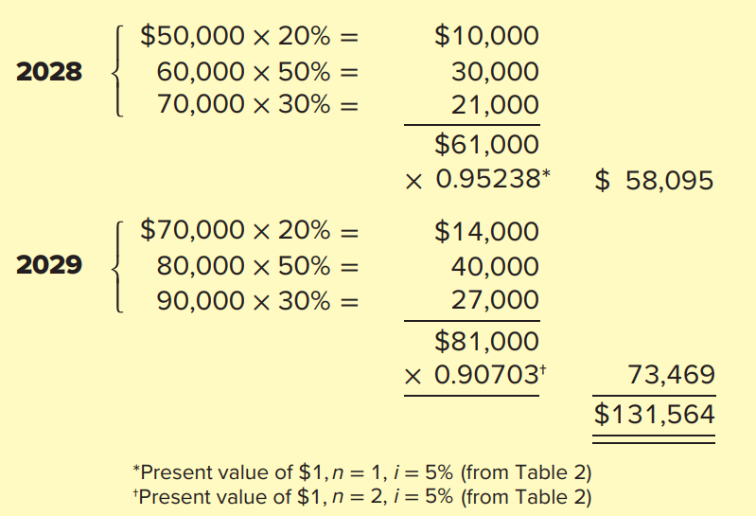
Product Warranty—Expected Cash Flow Approach 2
L O13.6
An arrangement with a service firm requires that costs for the two-year warranty period be settled at the end of 2028 and 2029. The risk-free rate of interest is 5%. Applying the expected cash flow approach, at the end of the 2027 fiscal year, Caldor would record a warranty liability (and expense) of $131,564, calculated as follows:
Access the text alternative for slide images.
Notes:
Illustration 13–18 Product Warranty (continued)
We know that we also must determine the time value of these expected cash flow amounts. We use a risk-free interest rate of 5%, as the uncertainty associated with cash flows has already been included in our estimates by using expected values.
The expected cash flows amount for 2028 is $61,000. When that number is discounted by the present value factor for one year at 5%, which is 0.95238, the present value is $58,095. The present value of the warranty cost for 2029 is $73,469. The present value of the total warranty cost is thus $131,564.

Slide 50
Product Warranty—Expected Cash Flow Approach 3
L O13.6
Journal Entry | Debit | Credit
December 31, 2027 (adjusting entry)
Warranty expense | 131,564
Warranty liability (calculated above) |  | 131,564
Notes:
Illustration 13–18 Product Warranty (concluded)
Caldor Health will make an adjusting entry to record the present value of warranty liability on December 31, 2027, debiting warranty expense and crediting warranty liability for $131,564.

Slide 51

Extended Warranty Contracts
L O13.6
An extended warranty provides warranty protection beyond manufacturer’s original warranty.
Revenue recognition:
Recorded as a deferred revenue liability at the time of sale and,
Recognized as revenue over the contract period.
Priced and sold separately from the warranteed product.
A separate performance obligation.
Straight-line basis.
Notes:
An extended warranty provides warranty protection beyond the manufacturer’s original warranty. Because an extended warranty is priced and sold separately from the warranteed product, it constitutes a separate performance obligation. That means our focus isn’t on recognizing a contingent liability. Rather, it is accounting for revenue and related costs associated with the extended warranty.
Because an extended warranty provides coverage over a period of time, these arrangements typically qualify for revenue recognition over the period of coverage. However, cash typically is received up front when the extended warranty is sold. Similar to other advanced payments for future products and services, revenue from extended warranty contracts is not recognized immediately, but instead is recorded as a deferred revenue liability at the time of sale and recognized as revenue over the contract period, typically on a straight-line basis.

Slide 52
Extended Warranty
L O13.6
Brand Name Appliances sells major appliances that carry a one-year manufacturer’s warranty. Customers are offered the opportunity at the time of purchase to also buy a three-year extended warranty for an additional charge. On January 3, 2027, Brand Name sold a $60 extended warranty, covering years 2028, 2029, and 2030.
Journal Entry | Debit | Credit
January 3, 2027
Cash (or accounts receivable) | 60
Deferred revenue—extended warranties |  | 60
December 31, 2028, 2029, 2030 (adjusting entries)
Deferred revenue—extended warranties | 20
Revenue–extended warranties ($60 ÷ 3) |  | 20
Notes:
Illustration 13–19 Extended Warranty
This illustration demonstrates accounting for extended warranties. When the extended warranty is sold, Brand Name receives cash and records a liability, deferred revenue—extended warranties for $60.
Every year for the next three years, deferred revenue is debited and revenue is credited by $20 for the extended warranty, recognizing that Brand Name has fulfilled a year’s worth of performance obligation by providing warranty coverage during that year.
The costs incurred to satisfy customer claims under the extended warranties will be recorded during the same three-year period that revenue is recognized. That way, net income in each year of the extended warranty will reflect both the warranty revenue recognized and the costs associated with that revenue.

Slide 53
Disclosure of Litigation Contingencies
L O13.6
Pending litigation is not unusual.
Accrual of a loss from pending or ongoing litigation is rare.
Outcome of litigation is highly uncertain.
Loss is usually not recorded until after ultimate settlement.
While companies should provide extensive disclosure of these contingent liabilities, they do not always do so,
Note 30. Litigation (in part):
As of December 31, 2022, the Firm and its subsidiaries and affiliates are defendants or respondents in numerous legal proceedings, including private, civil litigations, government investigations or regulatory enforcement matters. . . . The Firm believes the estimate of the aggregate range of reasonably possible losses, in excess of reserves established, for its legal proceedings is from $0 to approximately $1.2 billion at December 31, 2022. This estimated aggregate range of reasonably possible losses was based upon information available as of that date for those proceedings in which the Firm believes that an estimate of reasonably possible loss can be made.
Notes:
Illustration 13–20 Disclosure of Litigation Contingencies—JP Morgan Chase & Company
Pending litigation is not unusual. In fact, most medium and large corporations annually report multiple loss contingencies due to litigation. In practice, accrual of a loss from pending or ongoing litigation is rare. While companies may accrue estimated lawyer fees and other legal costs, they usually do not record a loss until after the ultimate settlement has been reached or negotiations for settlement are substantially completed. While companies should provide extensive disclosure of these contingent liabilities, they do not always do so in practice. In 2010, the SEC began pressuring firms for more complete disclosure of litigation, including better descriptions of the range of losses that are reasonably possible to occur. As an example, here we see a few excerpts from the eight pages of litigation note appearing in JP Morgan Chase & Company’s 2022 annual report.

Slide 54
Disclosure of a Lawsuit— Yum! Brands, Inc.
L O13.6
Even after a firm loses in court, it may not make an accrual.
Note 20. Contingencies (in part):
On January 29, 2020, the Special Director issued an order imposing a penalty on Y R I P L and certain former directors of approximately Indian Rupee 11 billion, or approximately $135 million. Of this amount, $130 million relates to the alleged failure to invest a total of $80 million in India within an initial seven-year period. We have been advised by external counsel that the order is flawed and have filed a writ petition with the Delhi High Court, which granted an interim stay of the penalty order on March 5, 2020.... We deny liability and intend to continue vigorously defending this matter. We do not consider the risk of any significant loss arising from this order to be probable.
Notes:
Illustration 13–21 Disclosure of a Lawsuit— Yum! Brands, Inc.
Even after a firm has a judgment issued against it, it may not make an accrual. As you can see in Illustration 13–21, Yum! Brands’ recent annual report disclosed but did not accrue damages from a regulatory enforcement action it lost, because the company was appealing the verdict.

Slide 55
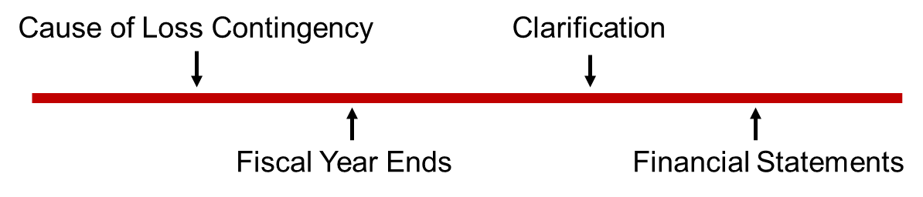
Subsequent Events & Accrual of Litigation Contingencies 1
L O13.6
Subsequent events can clarify a pre-existing claim’s.
Probability that a loss will occur.
Estimated amount of loss.
Note 15: Commitments and Contingencies (in part):
Legal Proceedings:
On December 6, 2010, Kraft commenced a federal court action against Starbucks, entitled Kraft Foods Global, Inc. versus Starbucks Corporation, in the U S District Court for the Southern District of New York. On November 12, 2013, the arbitrator ordered Starbucks to pay Kraft $2,227.5 million in damages plus prejudgment interest and attorney’s fees. We have estimated prejudgment interest, which includes an accrual through the estimated payment date, and attorneys’ fees to be approximately $556.6 million. As a result, we recorded a litigation charge of $2,784.1 million in our fiscal 2013 operating results.
Access the text alternative for slide images.
Notes:
Illustration 13–22 Accrual of Litigation Contingencies—Starbucks
Several weeks usually pass between the end of a company’s fiscal year and the date the financial statements for that year actually are issued or available to be issued. As shown on the time line, events occurring during this period can be used to clarify the nature of financial statement elements at the report date.
If information becomes available that sheds light on a claim that existed when the fiscal year ended, that information should be used in determining the probability of a loss contingency materializing and in estimating the amount of the loss.
The settlement of a lawsuit after Starbucks’ fiscal year ended apparently influenced its accrual of a loss contingency as shown in the disclosure note presented.
For a loss contingency to be accrued, the cause of the lawsuit must have occurred before the accounting period ended. It’s not necessary that the lawsuit actually was filed during that reporting period.

Slide 56
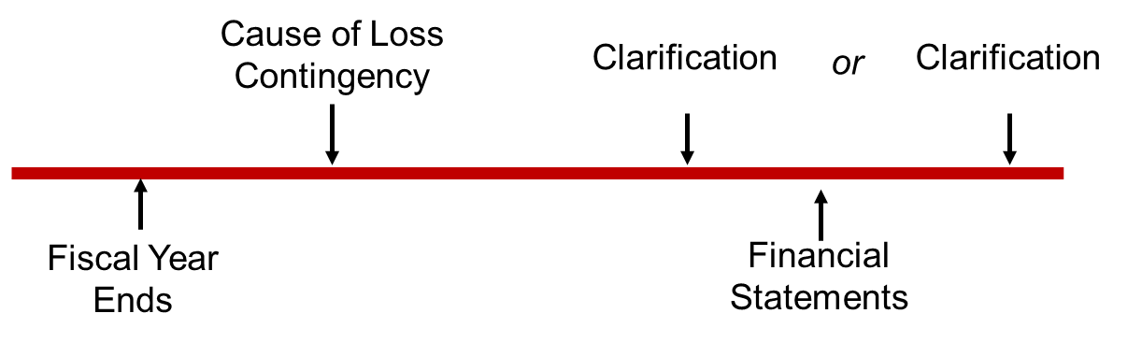
Subsequent Events & Accrual of Litigation Contingencies 2
L O13.6
If contingency comes into existence after fiscal year-end.
No liability accrued, but description provided in notes.
Note 1: Summary of Significant Accounting Policies (in part)
Subsequent Events
In January 2023, we reclassified fixed-rate debt securities with an aggregate fair value of $23.2 billion and amortized cost of $23.9 billion from held-to-maturity to available-for-sale and designated $20.1 billion in notional amounts of interest rate swaps as fair value hedges using the portfolio layer method, in connection with the adoption of A S U 2022- 01, Derivatives and Hedging (Topic 815): Fair Value Hedging—Portfolio Layer Method. The transfer of debt securities was recorded at fair value and resulted in $566 million of unrealized losses associated with available-for-sale debt securities being recorded to other comprehensive income, net of deferred taxes.
Access the text alternative for slide images.
Notes:
Illustration 13–23 Subsequent Events—Wells Fargo & Company
Sometimes, the cause of a loss contingency occurs after the end of the year but before the financial statements are issued, as shown on the timeline.
When a contingency comes into existence after the company’s fiscal year-end, a liability cannot be accrued because it didn’t exist at the end of the year. However, if the failure to disclose the possible loss would cause the financial statements to be misleading, the situation should be described in a disclosure note, including the effect of the possible loss on key accounting numbers affected.
In fact, any event occurring after the fiscal year-end but before the financial statements are issued that has a material effect on the company’s financial position must be disclosed in a subsequent events disclosure note.
The example here shows a disclosure note from Wells Fargo’s 2022 annual report, describing a material event that took place in January 2023, after the company’s December 31 year end but before the financial statements were issued.

Slide 57
Unasserted Claims and Assessments
L O13.6
Even if a claim has yet to be made when the financial statements are issued, a contingency may warrant accrual or disclosure.
A two-step process is involved:
Is it probable that a claim will be asserted? If the answer is “no,” stop. If “yes,” go on to step 2.
Treat the claim as if the claim has been asserted.
Note 17. Commitments and Contingencies (partial):
Asserted and Unasserted Claims—Various claims and lawsuits are pending against us and certain of our subsidiaries. We cannot fully determine the effect of all asserted and unasserted claims on our consolidated results of operations, financial condition, or liquidity. We have recorded a liability where asserted and unasserted claims are considered probable and where such claims can be reasonably estimated.
Notes:
Illustration 13–24 Unasserted Claims—Union Pacific Corporation
Sometimes companies are aware of a potential claim that has not yet been made. Such unasserted claims may require accrual or disclosure of a contingent liability. A two-step process is involved in deciding how the unasserted claim should be reported:
Is it probable that a claim will be asserted? If the answer to that question is “no,” stop. No accrual or disclosure is necessary. If the answer is “yes,” go on to step 2.
Treat the claim as if the claim has been asserted. That requires evaluating (a) the likelihood of an unfavorable outcome and (b) whether the dollar amount of loss can be estimated, just as we already have discussed for other loss contingencies for which a claim has already been asserted.
As described in a December 31, 2022, disclosure note seen here, Union Pacific concluded that some unasserted claims met the criteria for accrual under this two-step decision process.

Slide 58
International Financial Reporting Standards—Loss Contingencies
L O13.7
U S G A A P | I F R S
All accrued and possible obligations are referred to as “contingent liabilities.” | All accrued loss contingencies are referred to as “provisions” and possible obligations are referred to as “contingent liabilities.”
Higher threshold for “probable.” | Lower threshold for “probable.”
Uses the low end of the range to estimate the expenditure required to settle present obligation. | Uses the midpoint of the range to estimate the expenditure required to settle present obligation.
Loss contingencies are not typically discounted for time value of money. | If material, liabilities to be stated at present value.
Generally no disclosure or loss recognition on “onerous contracts.” | Recognizes provisions and contingencies for “onerous contracts.”
Notes:
Accounting for contingencies is part of a broader international standard, IAS No. 37, “Provisions, Contingent Liabilities and Contingent Assets.” Overall, accounting for contingent losses under IFRS is quite similar to accounting under U.S. GAAP. A contingent loss is accrued if it’s both probable and can be reasonably estimated; and disclosed if it’s of at least a remote probability. However, there are some important differences:
IFRS refers to accrued loss contingencies as “provisions,” and refers to possible obligations that are not accrued as “contingent liabilities.” The term “contingent liabilities” is used for all of these obligations in U.S. GAAP.
IFRS requires disclosure (but not accrual) of two types of contingent liabilities: (1) possible obligations whose existence will be confirmed by some uncertain future events that the company does not control, and (2) a present obligation for which either it is not probable that a future outflow will occur or the amount of the future outflow cannot be measured with sufficient reliability. U.S. GAAP does not make this distinction but typically would require disclosure of the same contingencies.
IFRS defines “probable” as “more likely than not” (greater than 50%), which is a lower threshold than typically associated with “probable” in U.S. GAAP.
If a liability is accrued, IFRS measures the liability as the best estimate of the expenditure required to settle the present obligation. If there is a range of equally likely outcomes, IFRS would use the midpoint of the range, while U.S. GAAP requires use of the low end of the range.
If the effect of the time value of money is material, IFRS requires the liability to be stated at present value. U.S. GAAP allows using present values under some circumstances, but liabilities for loss contingencies like litigation typically are not discounted for time value of money.
IFRS recognizes provisions and contingencies for “onerous” contracts, defined as those in which the unavoidable costs of meeting the obligations exceed the expected benefits. Under U.S. GAAP we generally don’t disclose or recognize losses on such money-losing contracts, although there are some exceptions (for example, losses on long-term construction contracts are accrued, as are losses on contracts that have been terminated).

Slide 59
Gain Contingencies
L O13.6
A gain contingency is an uncertain situation that might result in a gain.
Gain contingencies are not accrued.
This is an example of conservatism—we record uncertain losses but not uncertain gains.
Material gain contingencies are disclosed in the notes to the financial statements.
Notes:
A gain contingency is an uncertain situation that might result in a gain. For example, in a pending lawsuit, one side—the defendant—faces a loss contingency; the other side—the plaintiff—has a gain contingency. As we discussed earlier, loss contingencies are accrued when it’s probable that an amount will be paid and the amount can reasonably be estimated. However, gain contingencies are not accrued. The nonparallel treatment of gain contingencies is an example of conservatism, following the reasoning that it’s desirable to anticipate losses, but recognizing gains should await their realization.
Though gain contingencies are not recorded in the accounts, material ones are disclosed in notes to the financial statements. Care should be taken that the disclosure note not give “misleading implications as to the likelihood of realization.”

Slide 60
International Financial Reporting Standards—Gain Contingencies
L O13.7
U S G A A P | I F R S
Gain contingencies are never accrued. | Gain contingencies are accrued if future realization is “virtually certain” to occur.
Disclose when gain realization is “probable” but uses a higher threshold for “probable.” | Disclose when gain realization is “probable” but uses a lower threshold for “probable.”
Notes:
Under U.S. GAAP, gain contingencies are never accrued. Under IFRS, gain contingencies are accrued if their future realization is “virtually certain” to occur. Both U.S. GAAP and IFRS disclose contingent gains when future realization is probable, but under IFRS “probable” is defined as “more likely than not” (greater than 50%), and so has a lower threshold than it does under U.S. GAAP.

Slide 61
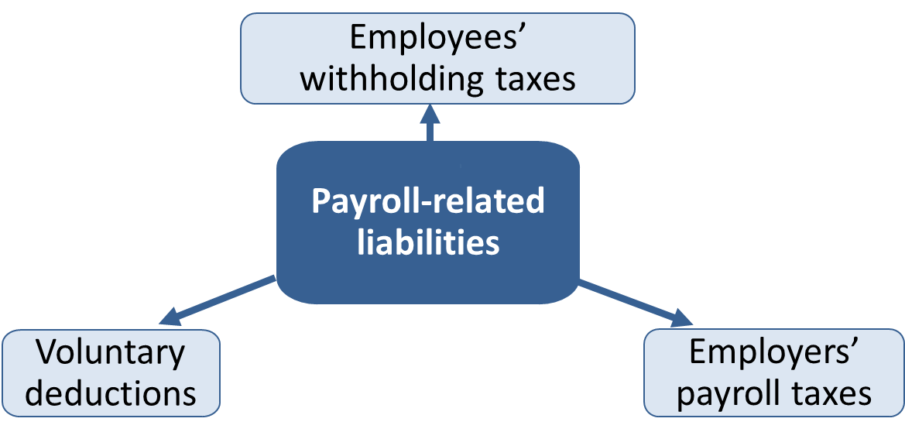
Payroll-Related Liabilities
Appendix 13
Legal requirements to withhold taxes from employees’ paychecks.
Legal requirements of the payroll taxes on firms.
Voluntary payroll deductions of amounts payable to third parties.
Access the text alternative for slide images.
Notes:
All firms incur liabilities in connection with their payrolls. These liabilities arise primarily from legal requirements to withhold taxes from employees’ paychecks and from payroll taxes on the firms themselves. Some payroll-related liabilities result from voluntary payroll deductions of amounts payable to third parties.

Slide 62
Employees’ Withholding Taxes
Appendix 13
Employers are legally required to withhold:
Federal (and sometimes state) income taxes.
Social Security taxes.
Remitted to taxing authorities.
Amount withheld varies with:
Amount of earnings.
Amount of exemptions claimed by employee.
Federal Insurance Contributions Act (F I C A) requires employers to withhold a percentage of each employee’s earnings up to a specified maximum.
Employees and employers both pay Social Security and Medicare.
Notes:
Employers are required by law to withhold federal (and sometimes state) income taxes and Social Security taxes from employees’ paychecks and remit these to the Internal Revenue Service. The amount withheld for federal income taxes is determined by a tax table furnished by the IRS and varies according to the amount earned and the number of exemptions claimed by the employee. Also, the Federal Insurance Contributions Act (FICA) requires employers to withhold a percentage of each employee’s earnings up to a specified maximum. Both the percentage and the maximum are changed intermittently.
As the time this document was created, the deduction for Social Security was 6.2% of the first $168,600 an employee earns, and this ceiling amount changes each year for cost-of-living adjustments. Additionally, a deduction for Medicare tax is 1.45%. The employer also must pay an equal (matching) amount on behalf of the employee. Individuals also must pay additional Medicare tax of 0.9% on wages in excess of a base that varies with a taxpayer’s filing status (there is no employer match against that additional Medicare tax). Self-employed persons must pay both the employer and employee portions (12.4% for Social Security and 2.9% for Medicare).

Slide 63
Voluntary Deductions, Employers’ Payroll Taxes, and Fringe Benefits
Appendix 13
Voluntary deductions:
Include union dues, contributions to savings or retirement plans, and insurance premiums.
Represent liabilities until paid to appropriate organizations.
Employers’ payroll taxes:
Employer’s matching amount of F I C A taxes.
Employer pays federal and state unemployment taxes on behalf of employees.
Fringe benefits:
Payment of employees’ insurance premiums and/or contributions to retirement income plans by employer.
Notes:
Besides the required deductions for income taxes and Social Security taxes, employees often authorize their employers to deduct other amounts from their paychecks. These deductions might include union dues, contributions to savings or retirement plans, and insurance premiums. Amounts deducted this way represent liabilities until paid to the appropriate organizations.
One payroll tax mentioned previously is the employer’s matching amount of FICA taxes. The employer also must pay federal and state unemployment taxes on behalf of its employees.
The Federal Unemployment Tax Act (FUTA) requires a tax of 6.0% of the first $7,000 earned by each employee. This amount is reduced by a 5.4% (maximum) credit for contributions to state unemployment programs, so the net federal rate can be as low as 0.6%. The most common state rate is 2.7%, but rates vary between states and also vary within states for different types of employers.
In addition to salaries, withholding taxes, and payroll taxes, many companies provide employees a variety of fringe benefits. Most commonly, employers pay all or part of employees’ insurance premiums and/or contributions to retirement income plans.

Slide 64
Payroll-Related Liabilities 1
Appendix 13
Crescent Lighting and Fixtures’ payroll for the second week in January was $100,000. The following deductions, fringe benefits, and taxes apply:
Federal income taxes to be withheld | $20,000
State income taxes to be withheld | 3,000
Medical insurance premiums (Blue Cross)—70% paid by employer | 1,000
Employee contribution to voluntary retirement plan (Fidelity Investments)—contributions matched by employer | 4,000
Union dues (Local No. 222)—paid by employees | 100
Life insurance premiums (Prudential Life)—100% paid by employer | 200
Social Security tax rate | 6.2%
Medicare tax rate | 1.45%
Federal unemployment tax rate (after state deduction) | 0.60%
State unemployment tax rate | 5.40%
Notes:
Illustration 13A–1 Payroll-Related Liabilities
Here’s an illustration of payroll-related liabilities. As you study the illustration, you should note the similarity among all payroll-related liabilities. Amounts withheld from paychecks—voluntarily or involuntarily—are liabilities until turned over to appropriate third parties. Payroll taxes and expenses for fringe benefits are incurred as a result of services performed by employees and also are liabilities until paid to appropriate third parties.

Slide 65
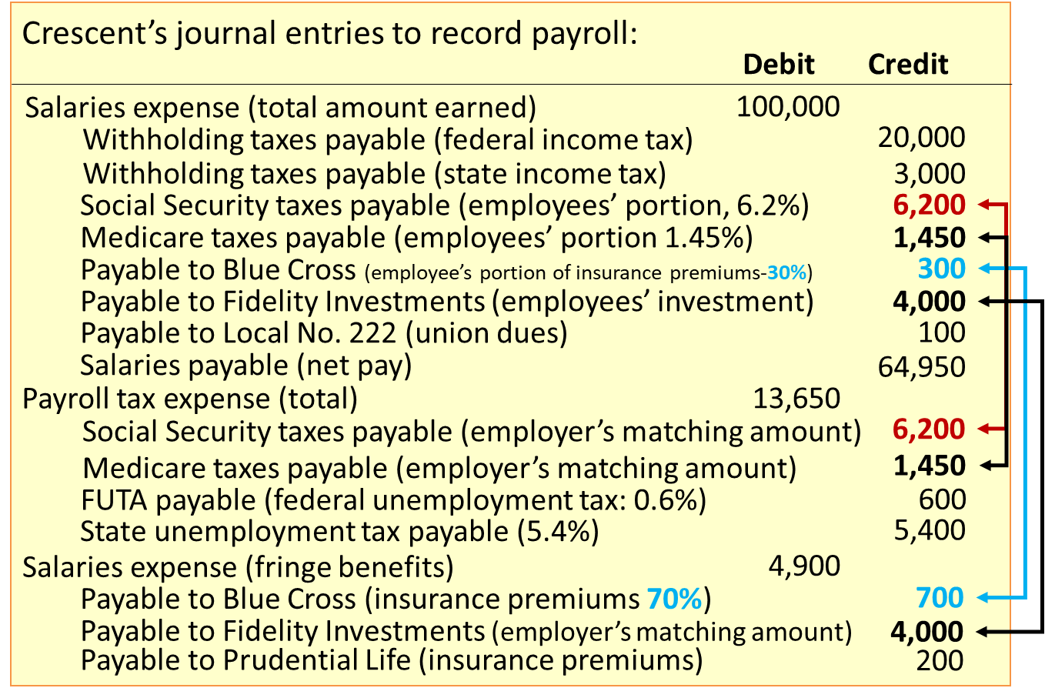
Payroll-Related Liabilities 2
Appendix 13
Access the text alternative for slide images.
Notes:
Illustration 13A–1 Payroll-Related Liabilities (continued)
Amounts withheld from paychecks—voluntarily or involuntarily—are liabilities until turned over to appropriate third parties. Payroll taxes and expenses for fringe benefits are incurred as a result of services performed by employees and also are liabilities until paid to appropriate third parties.

Slide 66
End of Main Content
© McGraw Hill LLC. All rights reserved. No reproduction or distribution without the prior written consent of McGraw Hill LLC.

Slide 67
Accessibility Content: Text Alternatives for Images

Slide 68
Short-Term Notes Payable – Text Alternative
Return to parent-slide containing images.
It presents the commercial paper, unsecured loans, credit lines, and secured loans lead to the financing alternatives.
Return to parent-slide containing images.

Slide 69
Credit Lines – Text Alternative
Return to parent-slide containing images.
Credit lines are divided into committed and noncommitted. Committed is then divided into a formal agreement and commitment-free to the bank to keep a credit line amount available to the company. Noncommitted is divided into informal agreement and borrow up to a prearranged limit without formal loan procedures. A text box at the bottom reads as follows. Borrower may be required to maintain a compensating balance in the bank.
Return to parent-slide containing images.

Slide 70
Liabilities from Advance Collections – Text Alternative
Return to parent-slide containing images.
Advance collections are divided into deposits and advances for customers, gift cards, and collections for third parties. The deposits and advances for customers are further divided into refundable deposits and advances from customers.
Return to parent-slide containing images.

Slide 71
Collections for Third Parties 2 – Text Alternative
Return to parent-slide containing images.
It has 3 columns and 3 rows. The column headers are journal entry, debit, and credit. The row headers are cash or account receivable, sales revenue, and sales tax payable. Sales tax payable has a credit of 7 dollars, representing a liability until remitted. The credit of 7 dollars is obtained from the outcome of 4% plus 3% multiplied by 100 dollars.
Return to parent-slide containing images.

Slide 72
Current and Noncurrent Classification – Text Alternative
Return to parent-slide containing images.
The long-term obligations, including bonds, notes, lease liabilities, and deferred tax liabilities, are reclassified as current liabilities when they become payable within the upcoming year or operating cycle, if longer than a year. 20-year bond leads to long-term liability for 19 years, resulting in the current liability in the 20th year of term to maturity.
Return to parent-slide containing images.

Slide 73
Product Warranty—Expected Cash Flow Approach 2 – Text Alternative
Return to parent-slide containing images.
2028. $50000 times 20% = $10000. 60000 times 50% = 30000. 70000 times 30% = 21000. $61000 times 0.95238 = $58095. 2029. $70000 times 20% = $14000. 80000 times 50% = 40000. 90000 times 30% = 27000. $81000 times 0.90703 = 73469. Total $131564.
Return to parent-slide containing images.

Slide 74
Subsequent Events & Accrual of Litigation Contingencies 1 – Text Alternative
Return to parent-slide containing images.
It presents a horizontal line with arrows pointing towards the line. From left to right. A downward arrow indicates cause of loss contingency, an upward arrow indicates fiscal year ends, a downward arrow indicates clarification, and an upward arrow indicates financial statements.
Return to parent-slide containing images.

Slide 75
Subsequent Events & Accrual of Litigation Contingencies 2 – Text Alternative
Return to parent-slide containing images.
It presents a horizontal line with 4 arrows pointing towards the line. From left to right. An upward arrow indicates fiscal year ends, a downward arrow indicates cause of loss contingency, a downward arrow indicates clarification, an upward arrow indicates financial statements, and a downward arrow at the rightmost indicates clarification.
Return to parent-slide containing images.

Slide 76
Payroll-Related Liabilities – Text Alternative
Return to parent-slide containing images.
It includes employees' withholding taxes, employers' payroll taxes, and voluntary deductions.
Return to parent-slide containing images.

Slide 77
Payroll-Related Liabilities 2 – Text Alternative
Return to parent-slide containing images.
Crescent's journal entries to record payroll. Salaries expense, total amount earned. Debit, 100000. Withholding taxes payable, federal income tax, credit, 20000. Withholding taxes payable, state income tax, credit, 3000. Social security taxes payable, employees' portion, 6.2%. Credit, 6200. Medicare taxes payable, employees' portion 1.45%. Credit, 1450. Payable to Blue Cross, employees' portion of insurance premium, 30%, credit, 300. Payable to fidelity investments, employees' investment, credit, 4000. Payable to local number 222 union dues, credit 100. Salaries payable net pay, 64950. Payroll tax expense, total, debit, 13650. Social security taxes payable, employer's matching amount, credit, 6200. Medicare taxes payable, employer's matching amount, credit 1450. F U T A payable, federal unemployment tax, 0.6%, credit 600. State unemployment payable 5.4%, credit 5400. Salaries expense, fringe benefits. {payable too Blue Cross, insurance premium 70%, credit 700. Payable to fidelity investments, employer's matching amount, 4000. Payable to Prudential Lide insurance premiums, credit 200.
Return to parent-slide containing images.

